Slide 1
Adult Education & Literacy Advisory Committee Meeting (Virtual)
Wednesday
June 22, 2022
1:30 pm CST

Slide 2
AEL Advisory Committee
Member | Location | Representing | Affiliation | Term Expires
Steve Banta (Presiding Officer) | Dallas/ Fort Worth | Nonprofit | Executive Director, Literacy Texas | December 2023
Diana Contreras | San Antonio | Employer | Sr. Director of Operational Effectiveness -Supply Chain, Dollar General Corporation | December 2023
Rita Hernandez | Brownsville | Nonprofit/ Career School | President, Cameron County Education Initiative | April 2023
Jauneen Maldonado | Fort Worth | Workforce Board | Director, Adult Education, Workforce Solutions for Tarrant County | December 2023
Brenda Schofield | Beaumont | AEL Provider | Director of Adult Education and Literacy, Region 5 Education Service Center | December 2023

Slide 3
June 22, 2022 Agenda
TWC Welcome
TWC AEL Updates
TWC Adult Education and Literacy Updates
Building a Talent Strong Texas Plan (Suzanne Morales-Vale, PhD Texas Higher Education Coordinating Board)
Committee Business Discussion
Addressing the Digital Divide: Achieving Digital Equity in Texas for Adult Learners

Slide 4
TWC AEL Updates
Digital Equity and Remote Learning

Slide 5
Transition to Remote/Virtual Services
TWC investments to support the transition
Immediate Challenges: device access, instructional support, face-to-face interviews to assess a customer now remote
What We Learned: More options for customers; programs became tech savvy (but support still needed)
Notes:
Immediate Pandemic Response in April 2020 for Devices/Virtual Options:
TWC expanded a $2M Workforce Integration initiative and released another $1M to programs to allow for the initiation/expansion of distance and remote learning options. The initiative allowed for the purchase of software and hardware and the creation of laptop loaner programs so students could continue to connect to services virtually during the pandemic.
TWC approved an additional $240K to the student support call center to provide adult learners more remote learning options.
Approved $500K to develop 40 virtual learning video lessons (offered in bilingual English/Spanish) in the areas of basic education, digital literacy, workforce preparation, and job search assistance.
Digital Literacy Expansion: In April 2021, TWC approved a $1M Distance Education Professional Development Center to provide both adult learners and instructors immediate technical assistance with their digital/technology device questions through phone and live chat. The TA is available seven days a week in both English, Spanish, and other languages as needed to assist customers.
Innovation in Access: In August 2021, TWC invested $3.8M in the first statewide distance education virtual provider pilot program with UT Austin and Texas Tech to give adult learners a 100% virtual option to obtain a high school diploma or equivalent

Slide 6
More than 1/3 of AEL customers access instruction through asynchronous distance learning. Digital confidence leads to faster and improved outcomes for students through hybrid learning models.

Slide 7
TWC Continues Support
We have to build …
Digital Literacy
Digital Fluency
Cybersecurity Awareness
Distance Education PD Center
Technical assistance for instructors & students
Live chat, call center to be accessible so technology how-to’s aren’t the barrier to learning
https://www.txdistanceedhelp.com/

Slide 8
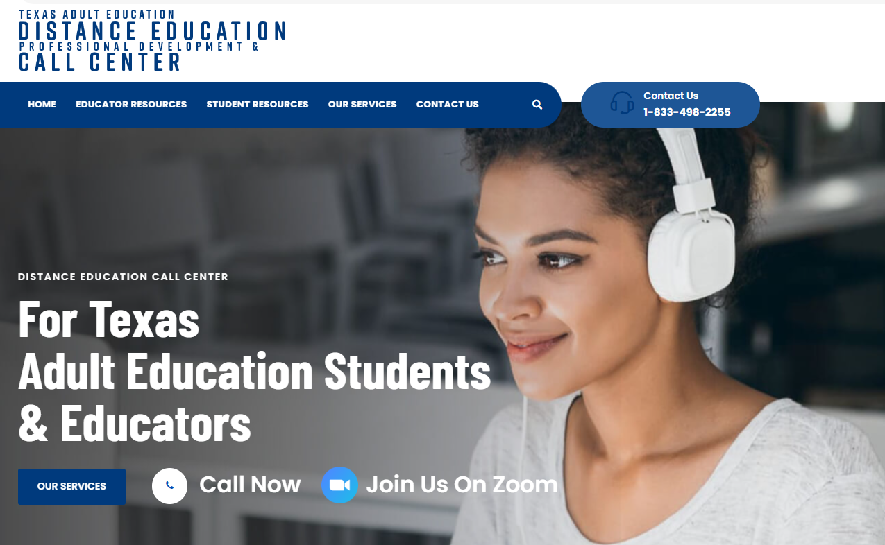
Distance Education Call Center website

Slide 9
Building a Talent Strong Texas Plan
Suzanne Morales-Vale, PhD
Texas Higher Education Coordinating Board,
Division for College Readiness and Student Success
The plan is available at https://www.highered.texas.gov/about-us/talentstrong/

Slide 10
Building a Talent Strong Texas

Slide 11
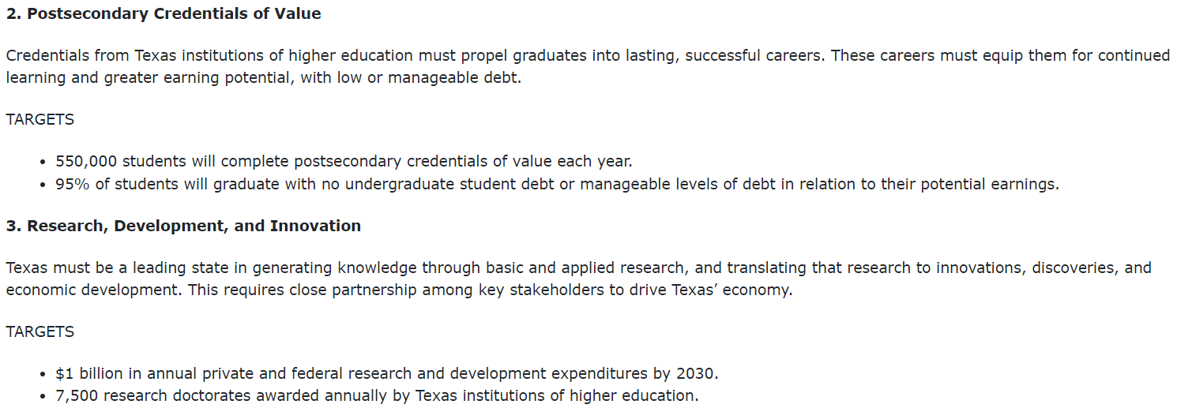
Building a Talent Strong Texas Continued

Slide 12
Building a Talent Strong Texas (Plan)

Slide 13
Committee Discussion
Digital Equity for Adult Learners

Slide 14
Digital Equity for Adult Learners
Digital Equity Challenges: How does the digital equity challenge manifest itself in the community, programs and businesses represented by the Advisory Committee?
Response to these Challenges: What actions have the committee members taken to identify and address the technology related issues to providing adult literacy services?
What has been successful and why?
What has not lived up to expectations and why?
Is funding for your program(s) an issue?
Resources Available: Is it clear what resources, technology and services are available to assist adult literacy providers?
Is there a more effective way to educate adult literacy providers of the available resources?

Slide 15
Digital Equity for Adult Learners Continued
Tarrant County Symposium: Tarrant county will bring together all providers of adult literacy in a symposium on June 25th to address the effects of the pandemic on the county. Please share what drove the need for this symposium and what outcomes are hoped to be achieved?
Tarrant County symposium could serve as a model. What would this look like?
Digital Texas. Is this a resource that adult literacy providers could use?
Rural Broadband Coalition. Is this a resource that could work with adult literacy providers to ensure access to students?
Committee Recommendations? What role could the TWC play in creating an environment for collaboration in communities to address the digital divide challenge?

Slide 16
Closing Remarks

Slide 17
Next AEL Advisory Committee Meeting
September 14, 2022
December 7, 2022

